Slide 1


Final Presentation
Client: Mr. Eijlers
Tutor: Mr. Haak
Group 1:
Fangzhou Chen
Jiacong Li
Marco Hoogesteger
Martijn Crombeen
Group 1
21-1-2021

Slide 2
Contents
Research
V-model
Build-up
Simulating
Confirm components
Initial test setup
Empirical data
Demonstration

Slide 3

Research
Digital twin
Original calculation chain
Starts at throttle
Revised calculation chain
Starts at boat velocity
Datasheets BOX/SLACK
Solarboat

Slide 4
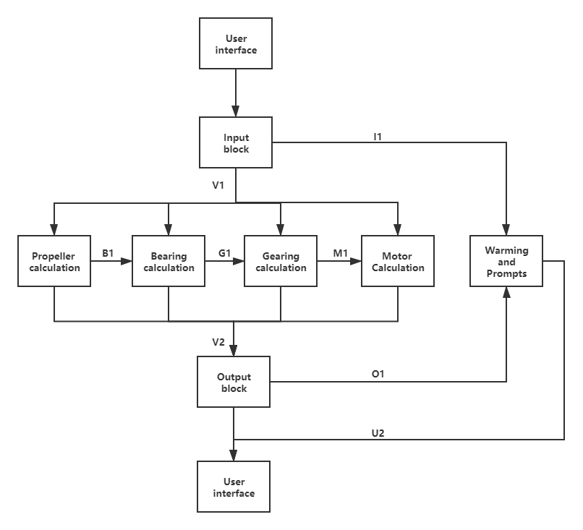
V-model
System
Sub-system calculations
System design
Subsystem design
Component design
Component integration
Subsystem integration
System integration
Component

Slide 5
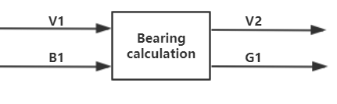
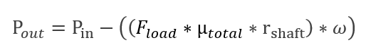
Buildup
Bearing calculation
Properties
Variables
Bearing
Friction coefficient | 0,0015
Seal coefficient | 0,0015
Load [N] | 100
r_shaft [m] | 0,015
Values from propellor system
Rotation speed [rpm] | 148,6366
Torque [Nm] | 4,068674
Intermediate variables
Bearing output power [W] | 63,32969
P_loss [W] | 0,070043
Bearing input power [W] | 63,39973
P_loss [%] | 0,000954
Output values to gearing
Feedback rotation speed to gearing [rpm] | 148,6366
Feedback torque to gearing [Nm] | 4,073174

Slide 6
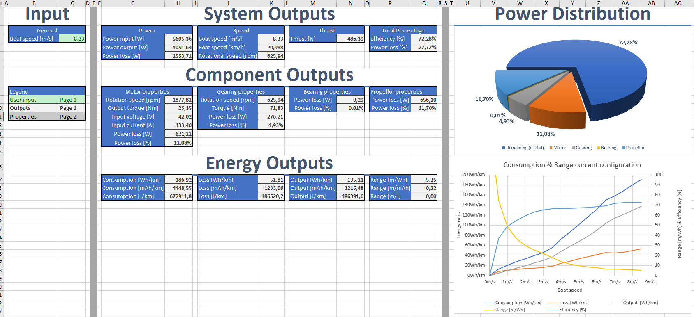
Buildup user interface

Slide 7
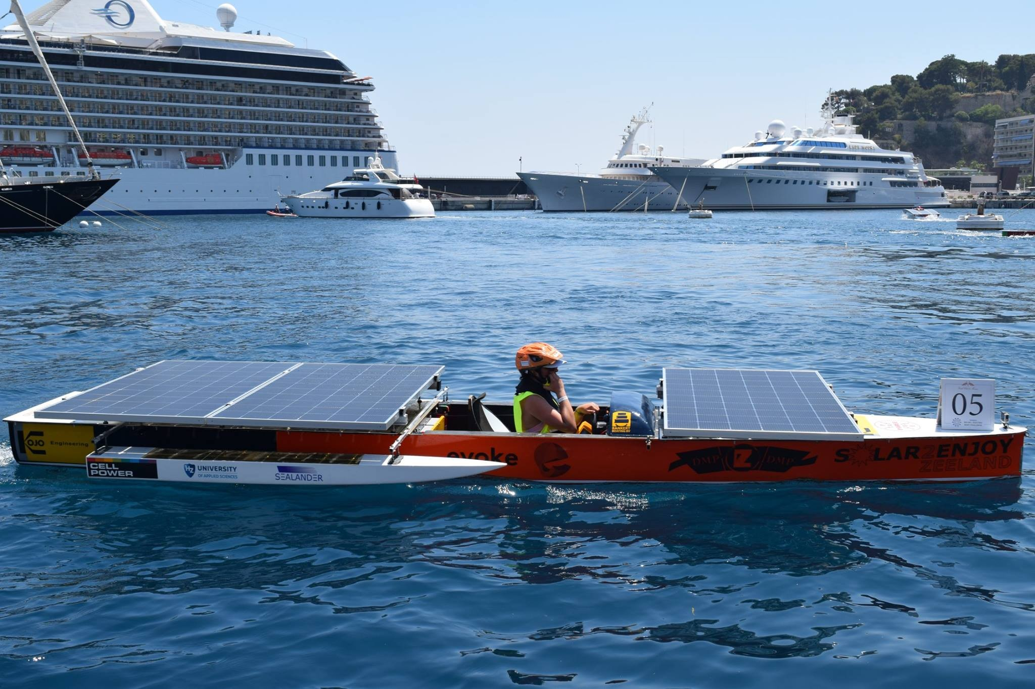
Simulating
Current solarboat situation

Slide 8
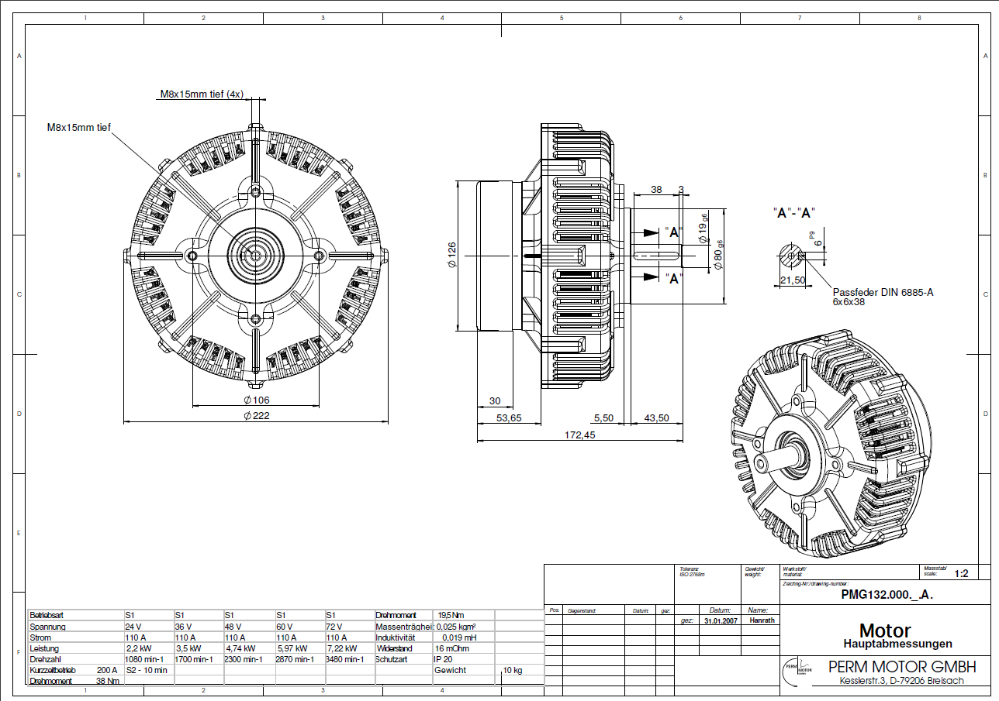
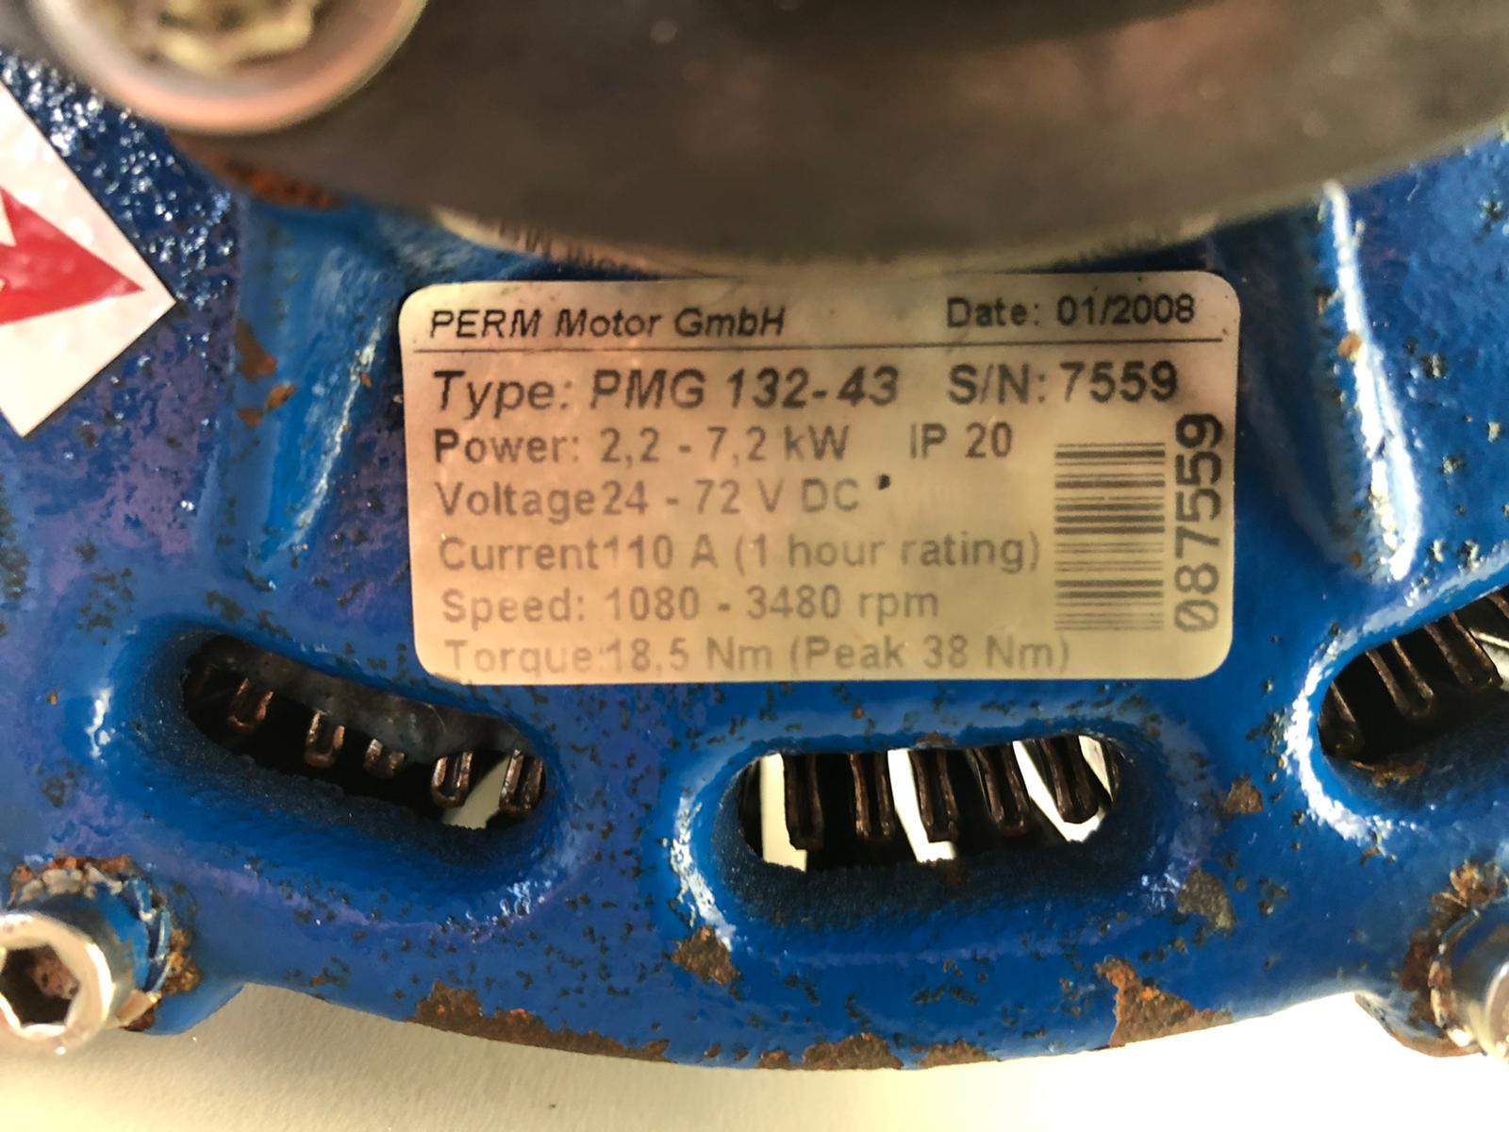
Confirm motor component

Slide 9
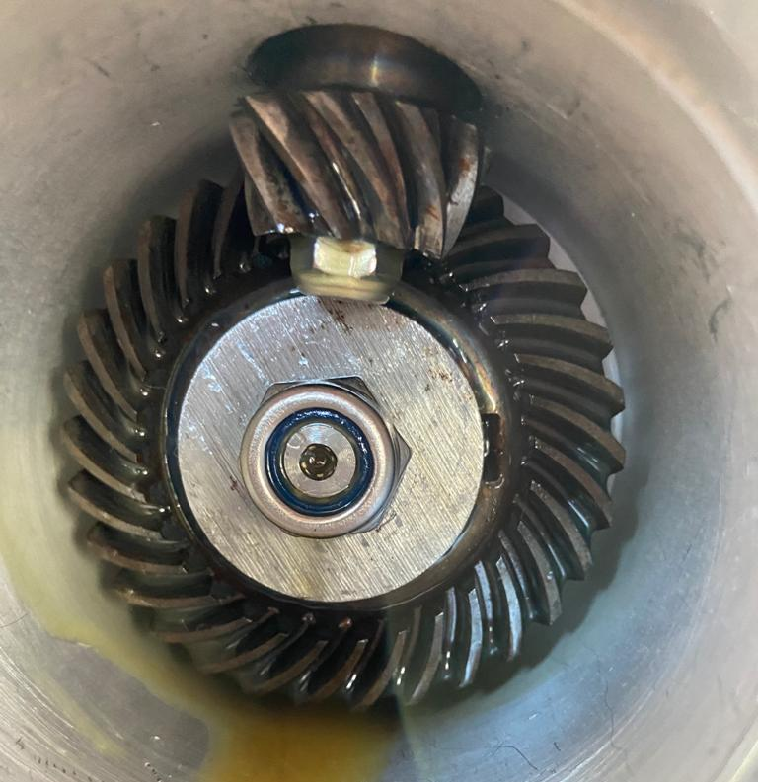
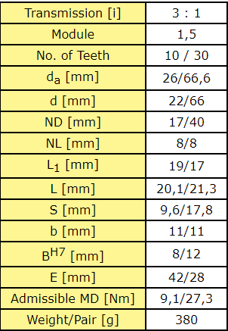
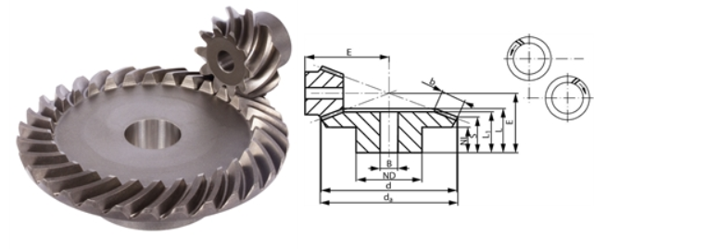
Confirm gearing component

Slide 10
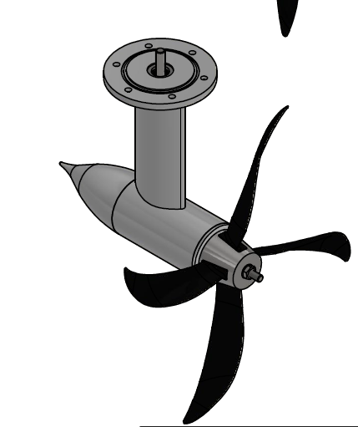
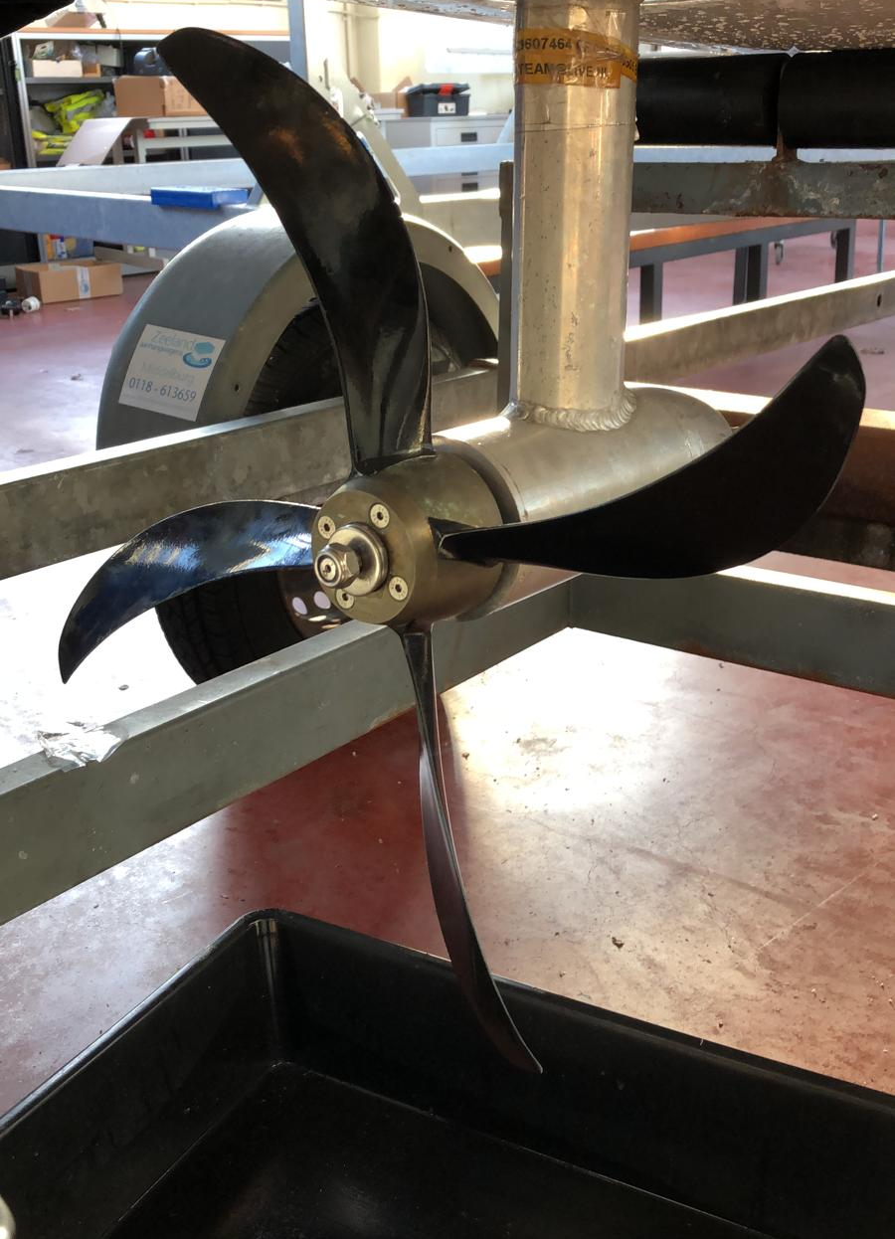
Confirm propellor component
Measured 48 cm
4 blades
Same as MAROF sheet, ENG calculations

Slide 11
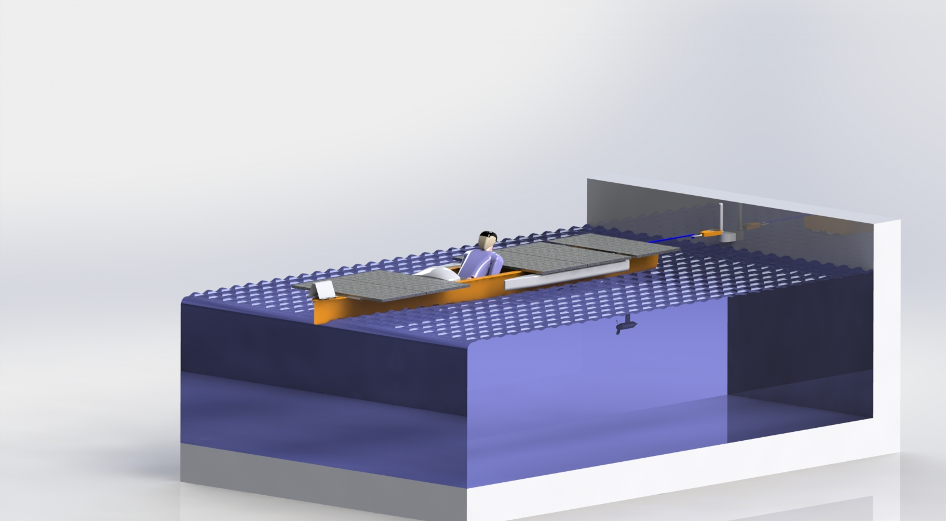
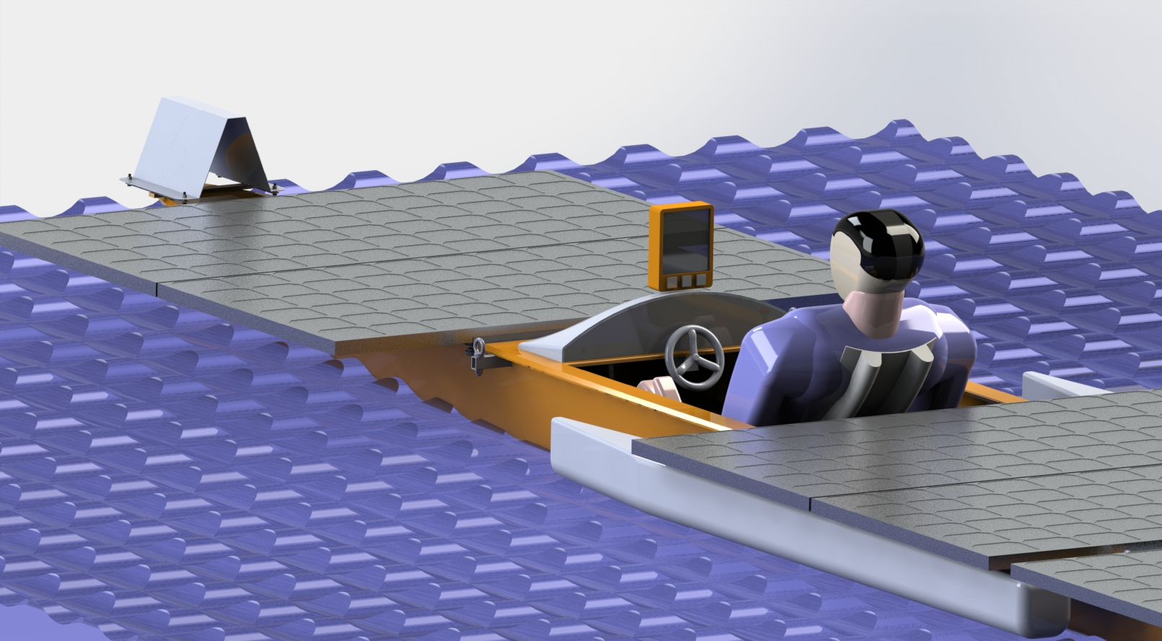
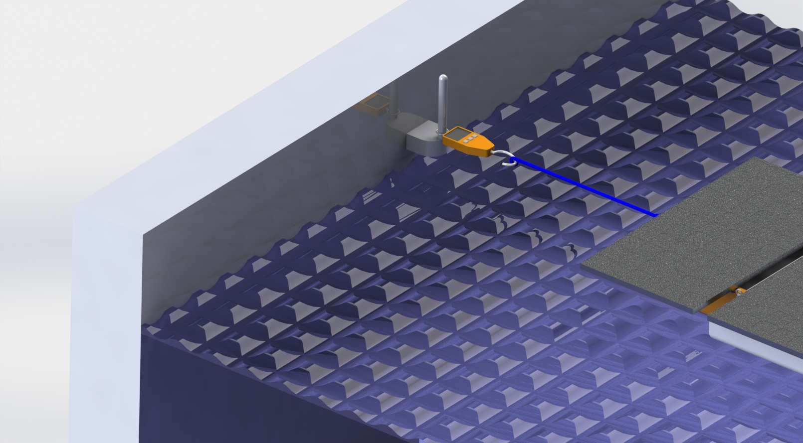
Initial test setup
Thrust test setup
Velocity test setup

Slide 12
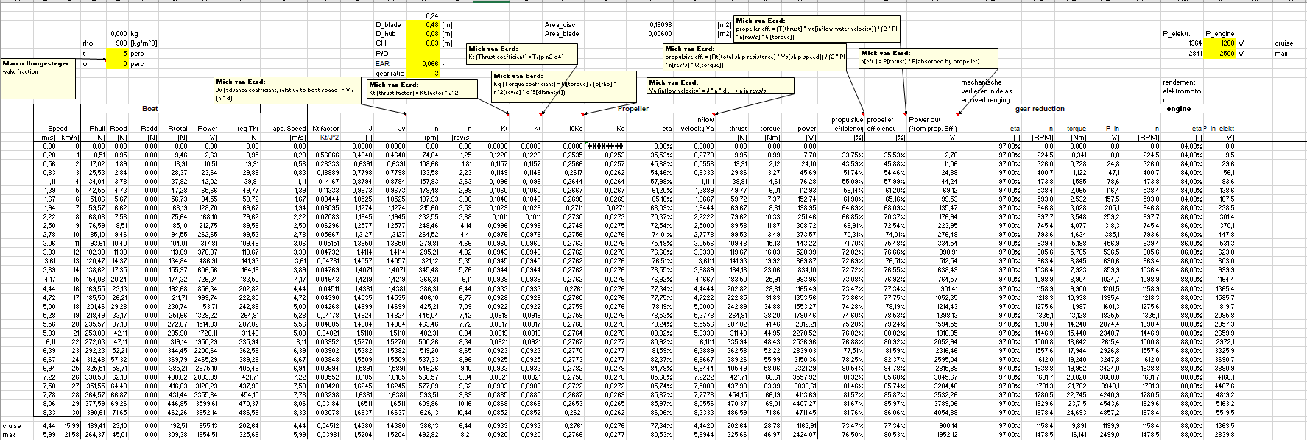
Empirical data
MAROF
Engineering

Slide 13

Demonstration

Slide 14
Questions?
Thank you for your attention!

